Slide 1
Cooking workshops

Slide 2
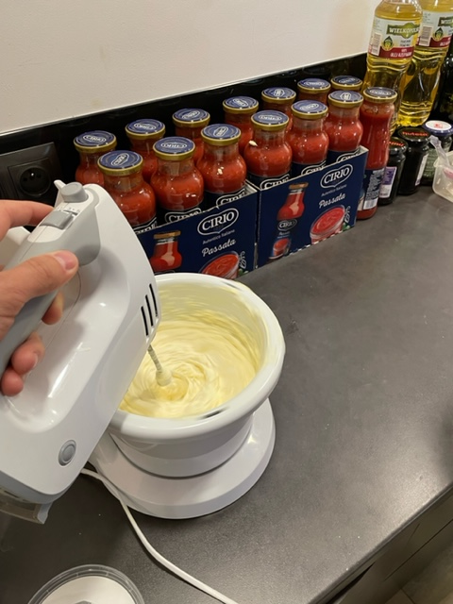
Mixing mascarpone with egg yolks

Slide 3
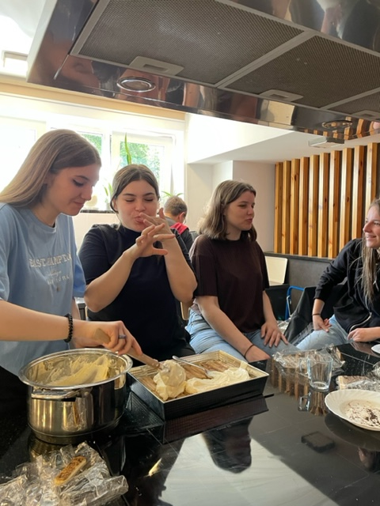
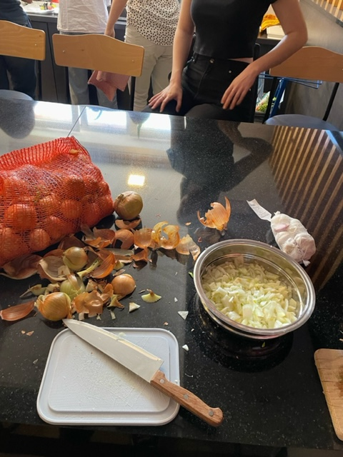
Tasting and spreading the cream on sponge fingers

Slide 4
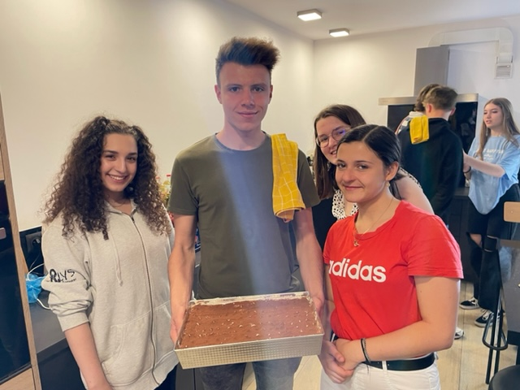
Presenting the final product

Slide 5
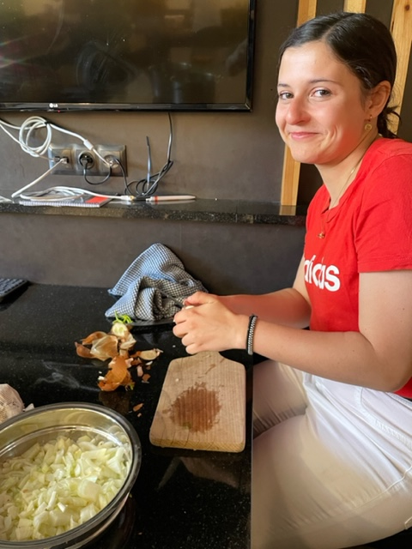
Cutting onions

Slide 6
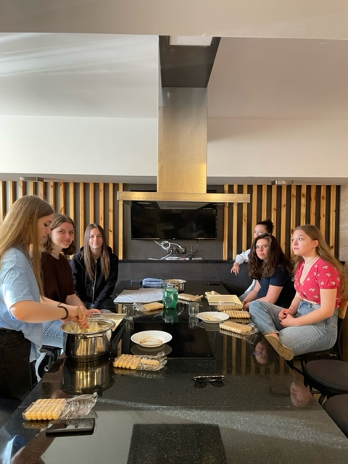
Having fun in the kitchen

Slide 7
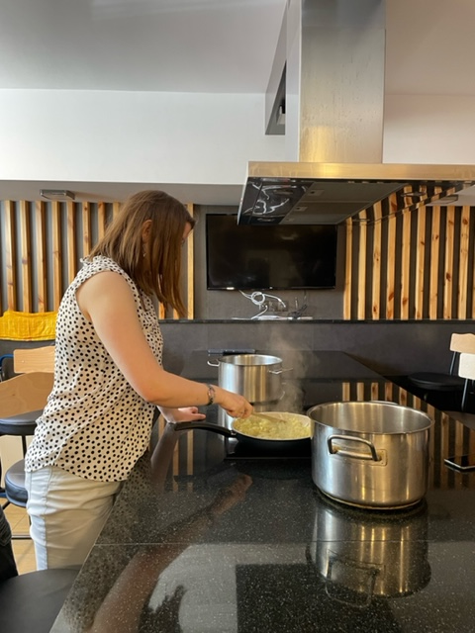
Frying onions and garlic

Slide 8
The End!

